Slide 1
Text Analysis of “I Have a Dream Speech by MLK Jr.”
Data Science for Business – Chapter 10
Representing and Mining Text
By
Don Padmaperuma (Geeth)

Slide 2
Text Analysis or Text Mining
This means obtaining meaningful information from unstructured data.
Text data is popular after internet became the most common channel of communication.
Many applications still produce or record text in the form of medical records, consumer complaint logs, product inquiries or repair records.
Text data need clean up as they are in linguistic structure which is not intended for computers.
For these reasons, text must undergo good amount of preprocessing before it can be used as data.

Slide 3
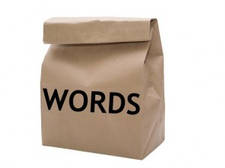
Bag-of-words
Treating each text document as just a collection of words.
Ignores grammar, word order, sentence structure, and usually punctuations.
Taking sequence of words and turning it into our familiar feature vector from.
Treats every word as a potentially important keywords of the document.

Slide 4
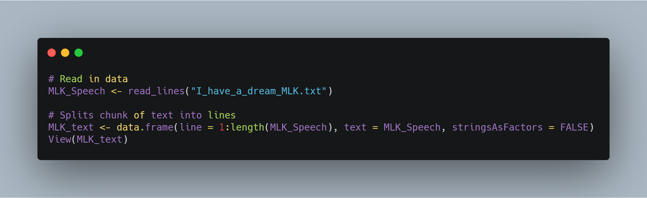
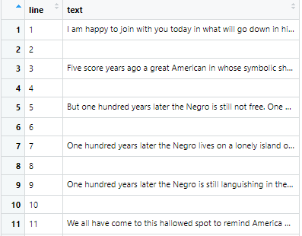
My approach to the Text Analysis of “ I Have a Dream speech”
As mentioned before, I am taking one of the most memorable speeches of all time “I Have a Dream” by Martin Luther King Jr. in text format.
And then convert into a data frame where each line is a vector of the data frame.

Slide 5
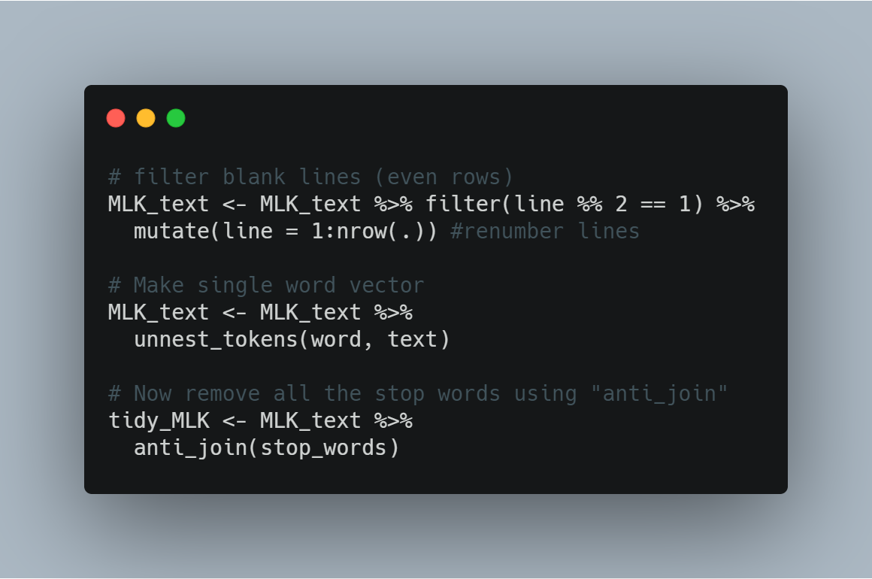
Using dplyr and tidytext R packages to do some further tidying of the data frame.
We need to get rid of the blank lines in between the sentences, then create a single word vector instead of sentence vectors. Unnest_tokens() function from tidytext is a way to covert a data frame with a text column to be one –token-per row. Token = a word. (we call this Tokenization)
Now that the data is in one-word-per-row fromat, we can use anti_join() tidy tool that comes with dplyr to remove stop words also known as common words such as “is”, “a”, “the”, “I”, “for”, “and” etc.

Slide 6
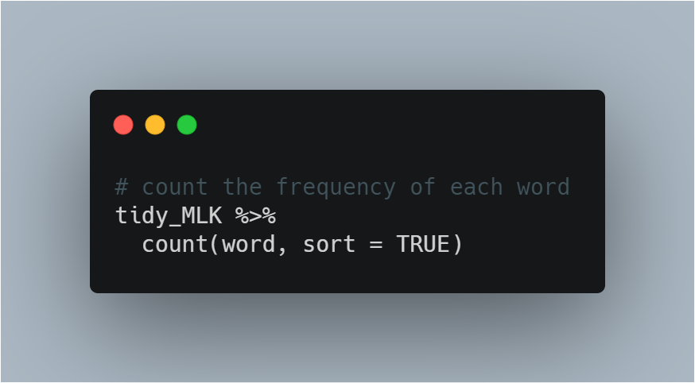
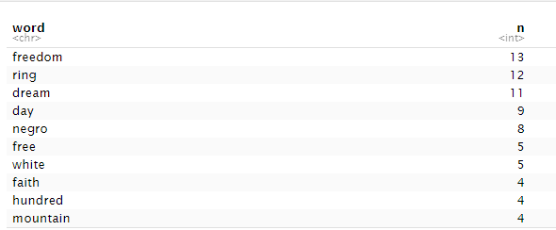
Frequency – word count of the text document. This allows us to find how many times a word is used. Usually, the importance of a term in a document should increase with the number of times that term occurs. This is called the term frequency.
We will do the same thing with our text to find out important words in the speech.

Slide 7
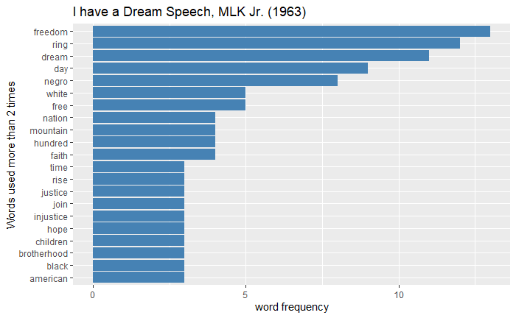
Text Analysis and Visualization
Word “freedom” the most frequently used word in the speech followed by the words “ring” and “dream”.

Slide 8
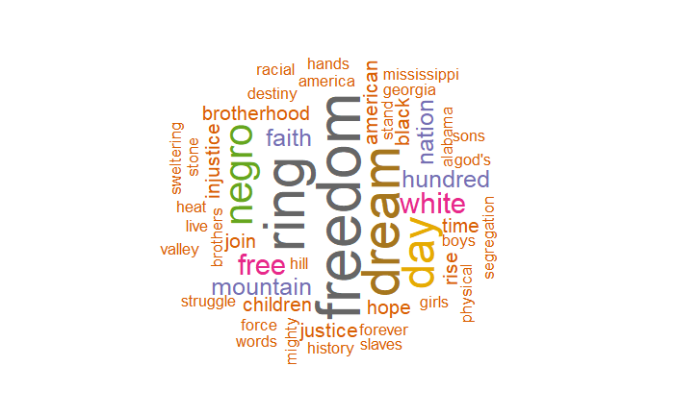
There is no better way to represent bag-of-words other than word cloud.
This word cloud clearly shows “freedom”, “ring” and “dream” as top 3 words used in Martin Luther King Jr. famous “I Have a Dream” speech that led to one of the biggest civil right movements in the U.S. history.

Slide 9
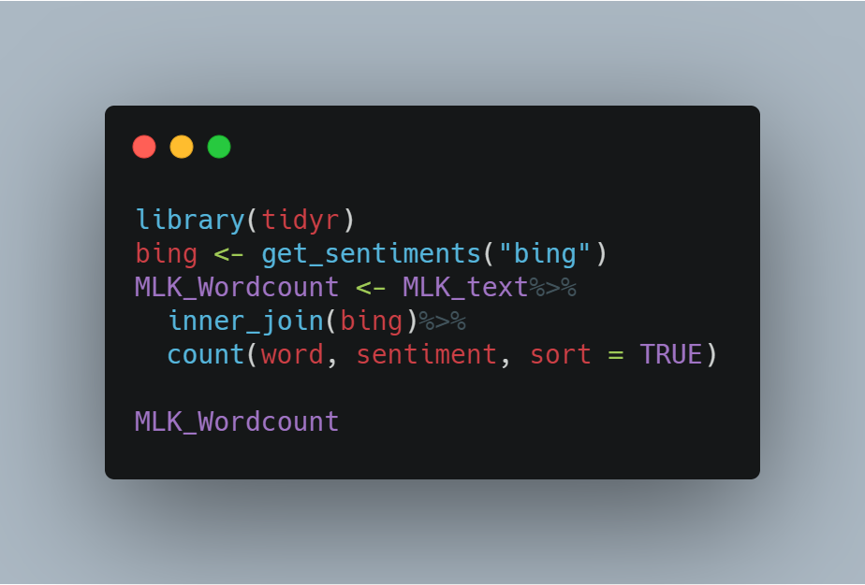
Another way to look at these data is to find both positive and negative words. So far we only look at most frequent words without putting them into any category. For this I used get_sentiments() function that comes with tidytext package. With that I used “bing” lexicon that based on unigrams( i.e. single words)

Slide 10
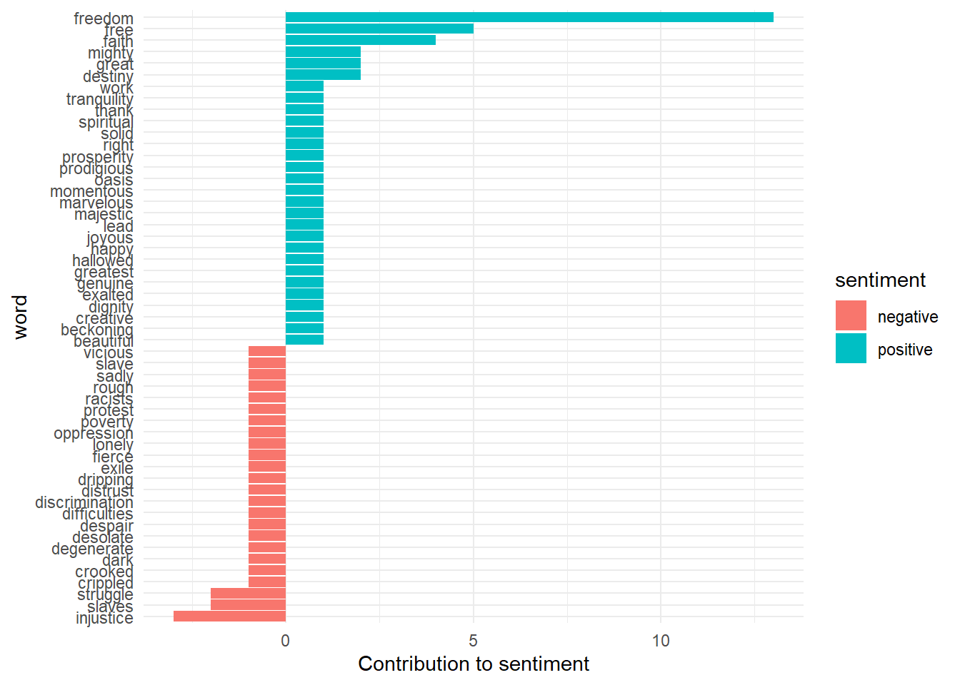
With this last analysis, I was able to see that most of the words that Martin Luther King Jr. used in his “I Have a Dream” speech are positive. His most frequently used positive word is “freedom”

Slide 11
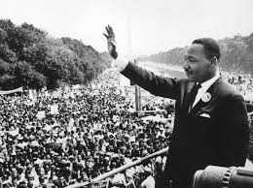
Conclusion
This visualization shows us that MLK Jr. used more positive words than negative words in his speech. May be this is one of the reasons why this speech is more memorable and impacted largely on civil right movement in 1960s. His positive word usage resulted the “I Have a Dream” speech to be so powerful, even after more than 50 years.

Slide 12
Reference
Data Science for Business – Chapter 10
Sentiment Analysis with tidy data - https://www.tidytextmining.com/sentiment.html
“I Have a Dream” speech – https://www.huffpost.com/entry/i-have-a-dream-speech-text_n_809993

